Slide 1
Electronics and Communication Engineering
A Seminar Presentation
By
AMIT PAUL
(16900317142, 6th SEM)
ANINDYA SARKAR
(16900317139, 6th SEM)
Under guidance of
Professor SUBHAM PRAMANIK

Slide 2
FLEXIBLE ELECTRONIC SKIN

Slide 3
INTRODUCTION
ELECTRONIC SKIN is a thin layer of material containing electronic sensors that is designed to mimic some of the properties of human skin , especially its sensitivity to pressure and temperature.
ELECTRONIC SKIN could monitor medical conditions such as electrical activity of the heart , brain waves and other vital signals.
It is used in various sectors such as robotics , health sectors , gaming sectors and more..

Slide 4
ABOUT ELECTRONIC SKIN
It is a replacement device for ECG(Electrocardiography) and EEG(Electroencephalogy).
There are various names of artificial skin in biomedical field it is called as Artificial Skin, in our electronics field it is called as Electronic Skin , some scientist called as Sensitive Skin and some even call it E-Skin.

Slide 5
AGENDA
Overview
Block Diagram
Development of E-Skin
Flexible Electronics
Architecture of E-Skin
Working of E-Skin
Fabrication of E-Skin
Advantages of E-Skin
Disadvantages of E-Skin
Flow-Chart
Application of E-Skin
Future Scopes of E-Skin
Conclusion

Slide 6
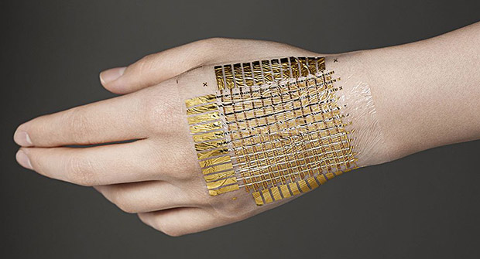
OVERVIEW
Main Objective of Artificial Skin
is to sense heat, pressure, touch, airflow and whatever which human skin senses. It is replacement for prosthetic limbs and robotic arms.
Fig 1: Basic Structure of Electronic Skin

Slide 7
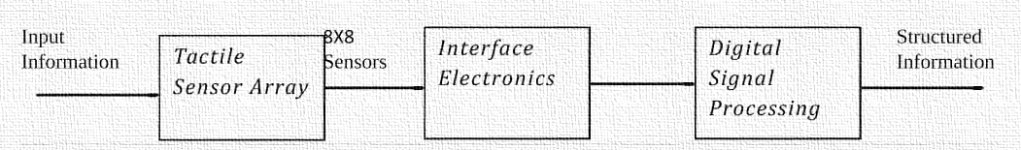
BLOCK DIAGRAM

Slide 8
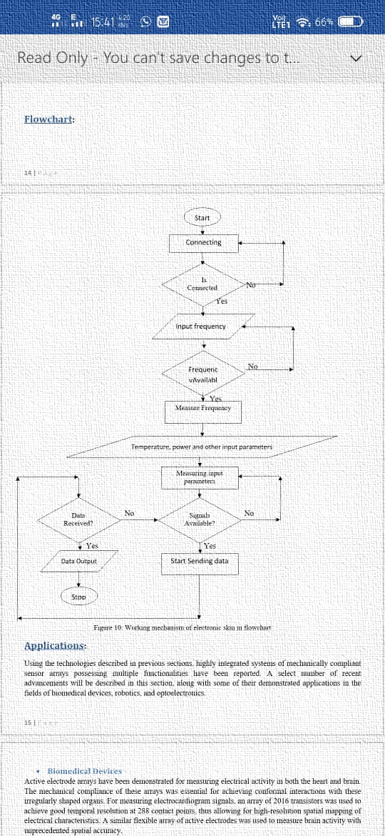
FLOW-CHART

Slide 9
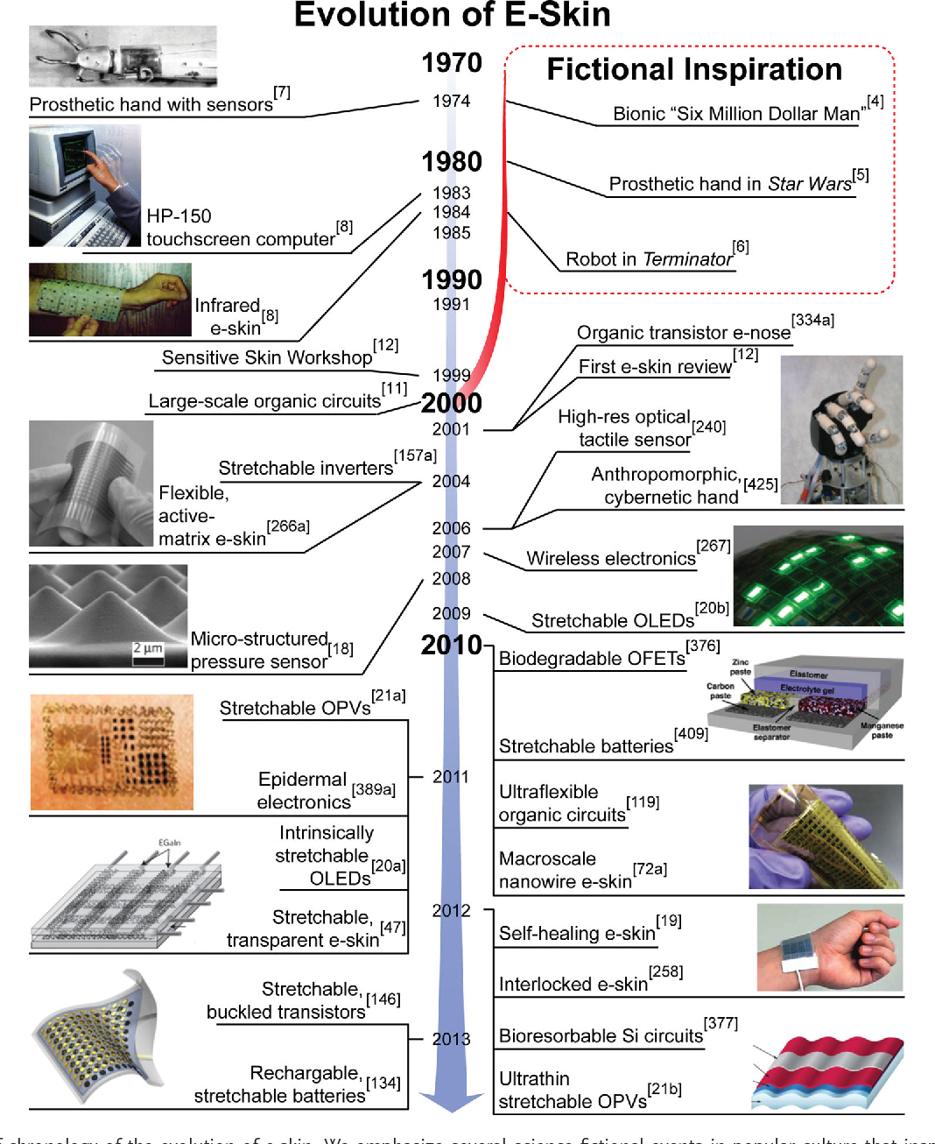
DEVELOPMENT OF E-SKIN
2010
Attacking nanowire transistors to sticky substrate,
embedded in thin pressure sensitive rubber-capsule
sensing wide range of pressures.
First prototype for E-Skin.
2011
Stretchable solar cell used to power the electronic skin.
2012
Self healing capacity
2013
Created an electronic skin that lights up when touched.

Slide 10
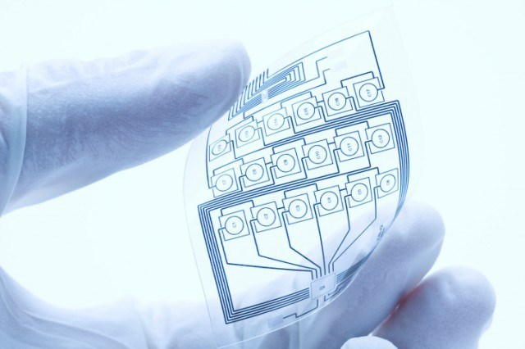
FLEXIBLE ELECTRONICS AND IT’S IMPLEMENTATION
Flexible electronics also known as “flex circuits”, is a technology for assembling electronic circuits by mounting electronic devices on flexible plastic substrates. Commonly, the substrates are made of polymide, PEEK or transparent conductive polyester film.
Materials are the heart of this technology. Flexibility can be attributed to a myriad of qualities ranging from how bendable a device is to whether it is manufactured using roll-to-roll process.
Flexible electronics is largely associated with active thin-film transistor(TFT) circuits. Thin Film Transistors(TFT’s) switch-on or switch-off each pixel on the display.
Nano-carbon materials as carbon nanotubes(CNTs) and grapheme are promising due to outstanding elastic properties as well as an excellent combination of electronic, optoelectronic, thermal properties for modification of flexible electronic skin.

Slide 11
ARCHITECTURE
Multifunctional structures, in which sensors and actuators are closely integrated with microelectronic circuits which brings a new dimension to electronics flexibility.
Shaped electronics and skin-like electronics may experience large deformation strains.
A disk detector array may see its surface area double to be shaped as a hemispherical detector array.
Semiconductor integrated circuits and MEMS technology use rigid and stiff substrates that are not adapted to flexible structures, and thin active device materials that fracture at a critical strain of 1% .

Slide 12
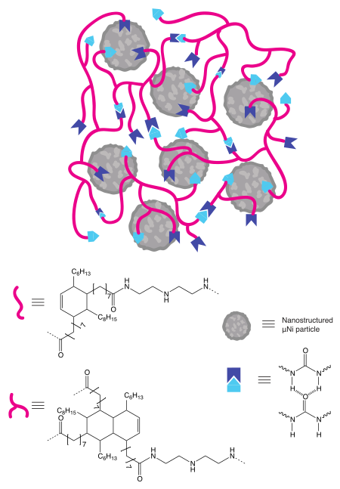
WORKING
Antenna is used to transmit the recorded electrical signals of skin to the receiver.
Strain Gauges are used for measuring the signals generated by the heart.
Temperature Sensors are used for measuring the temperature.
Light is a readily available power source, and is used to charge the E-Skin stretchable solar cells are used.

Slide 13
WORKING OF THE POLYMER NETWORKS
Polymer networks are able to facilitate dynamic healing processes through hydrogen bonds or dynamic covalent chemistry. The incorporation of micro-structured nickel particles into a polymer network has been shown to maintain self-healing properties based on the reformation of hydrogen bonding networks around the inorganic particles.
The material is able to regain its conductivity within 15 seconds of breakage, and the mechanical properties are regained after 10 minutes at room temperature without added stimulus.
This material relies on hydrogen bonds formed between urea groups when they align. The hydrogen atoms of urea functional groups are ideally situated to form a hydrogen-bonding network because they are near an electron-withdrawing carbonyl group.
This polymer network with embedded nickel particles demonstrates the possibility of using polymers as supramolecular hosts to develop self-healing conductive composites.

Slide 14
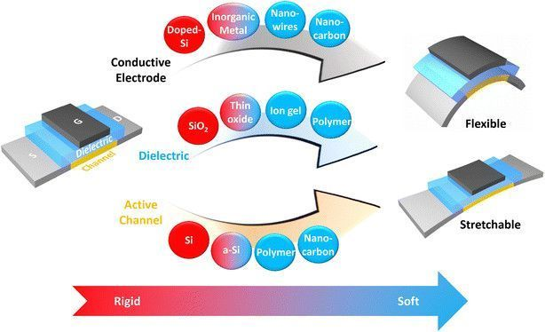
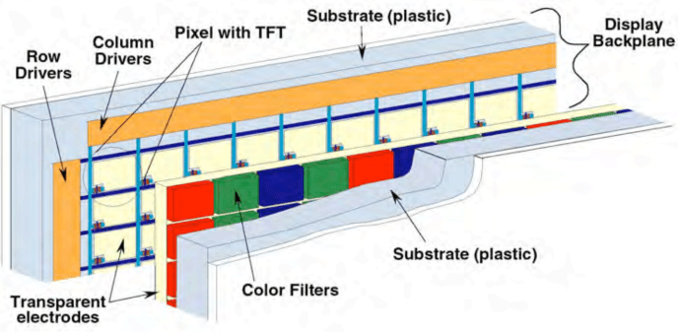
TECHNOLOGYCAL IDEA BEHIND FLEXIBILITY
We are mainly focusing on the role materials science played to aid the growth of a segment in flexible electronics which is largely associated with active thin-film transistor(TFT) circuits. Thin Film Transistors(TFT’s) switch-on or switch-off each pixel on the display. High Performance TFT’s are extremely important.
Silicon Technology has been the main driving force behind miniaturizing devices to reduce costs while improving its performance. The material rigidity of silicon is an impasse of its ubiquitous use in soft electronic(flexible and stretchable technologies) applications. This resulted in an extensive search of prospective materials by the research community that has the potential to overcome the rigidity of conventional silicon technology. From this flexible electronic components and integration with artificial skin has been a great step in technological history.

Slide 15
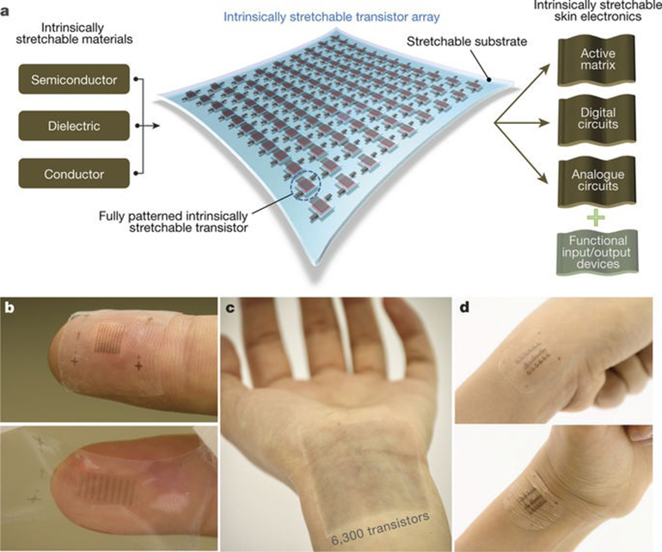
FABRICATION OF E-SKIN
By using zinc oxide with vertical nanowires.
By using gallium indium method.
By using organic transistors.
By organic light emitting diode.

Slide 16
ADVANTAGES
Reduces number of wires
Compact in size
Attachment and detachment is easy
More flexible
Light in weight
It replaces present system of ECG and EEG
It gives sense to a robot
Ultrathin
Twistable & stretchable
Easy to handle

Slide 17
DISADVANTAGES
Continuous emission of dead cells does not take place
Transpiration doesn’t take properly
Single Use
Cost is high

Slide 18
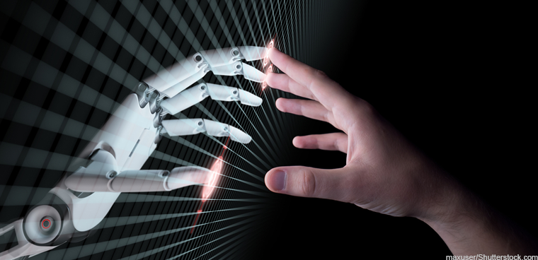
APPLICATIONS
Automatic Control Panel
Interactive Input Devices
Robotics
Medical & Health Monitoring Device
Biocompatibility and Biodegradibility
Self-Powering

Slide 19
FUTURE SCOPE
Bendable sensors and displays have made the tech rounds before.
We can predict a patient of an oncoming heart attack hours in advance.
In future even virtual screens may be placed on device for knowing our
body functions.
Used in car dashboard, interactive wallpapers, smart watches.

Slide 20
CONCLUSION
The electronics devices gain more demand when they are compact in size and best at functioning. The Artificial Skin is one such device which depicts the beauty of electronics and its use in daily life. Scientists create artificial skin that emulates human touch. According to experts, the artificial skin is “smarter and similar to human skin .” It also offers greater sensitivity and resolution than current commercially available techniques. Bendable sensors and displays have made the tech rounds before. We can predict a patient of an oncoming heart attack hours in advance. In future even virtual screens may be placed on device for knowing our body functions. Used in car dashboard, interactive wallpapers, smart watches.

Slide 21
ANY QUESTIONS ?

Slide 22
THANK YOU

